Slide 1
MultiCloud Network Architecture MCNA
ACE Technical Team

Slide 2
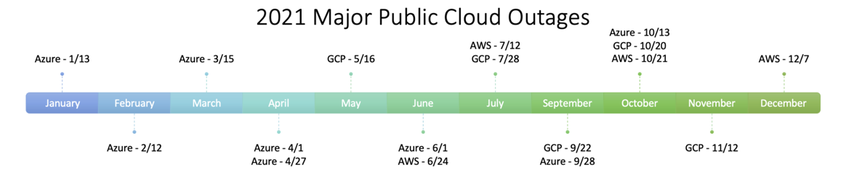
Multicloud Networking is a Must – Ask the Experts
Gartner
"By 2025, 35% of companies that use multiple public cloud providers will use a single network stack, an increase of over 10 times from May 2021.”¹
Forrester
“Multicloud Is Hard, But Single-Cloud Failures Make It Necessary For Enterprises.”²
Aviatrix
“You’re only in a single cloud until you’re multicloud.”
https://www.gartner.com/en/documents/4001639/market-guide-for-cloud-networking-software
https://www.forrester.com/blogs/multicloud-is-hard-but-single-cloud-failures-make-it-necessary-for-enterprises/

Slide 3
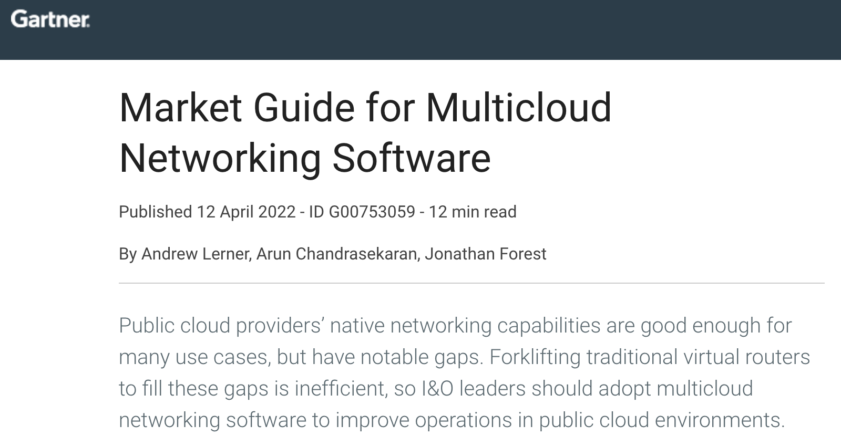
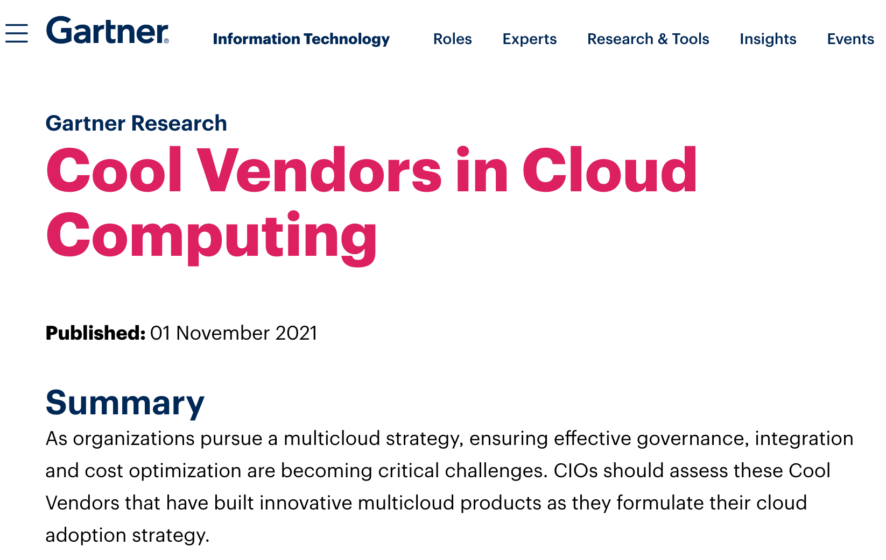
Gartner Reference Material
Market Guide for Multicloud Networking Software (MCNS)¹
“As organizations add new applications and scale existing ones into the public cloud, the shortcomings of the native cloud providers’ become more apparent.”
Key recommendations:
Don’t “forklift” traditional networking strategies into the public cloud.
Improve networking inside the public cloud by deploying MCNS when advanced networking features and/or a consistent network operations model across multiple public cloud environments is required.
Be able to address changing needs by making short-term MCNS investments, such as choosing consumption-based pricing, or a one to three-year time horizon.
Select MCNS offerings with strong security features (e.g., segmentation, encryption and firewall) and/or provide turnkey integration with selected security vendors.
Cool Vendors in Cloud Computing²
Organizations looking for advanced networking functionality missing from native public cloud providers and/or those that desire a consistent networking console across multiple public cloud providers, should shortlist Aviatrix
https://www.gartner.com/doc/reprints?id=1-29S4R0C1&ct=220419&st=sb
https://www.gartner.com/en/documents/4007802

Slide 4

Cloud Adoption Gap | Need for Standard Multicloud Network Architecture (MCNA)
Architectural
Gap and Limitation
Enterprise Data Center Networking
Cloud is New Data Center
Enterprise-Class Multicloud Networking and Security
Basic Cloud Networking
Evolution of
Networking
Virtual
Virtual
No
Customer
Access
Virtual
Physical
Physical
Physical
Physical
Private Cloud
On Premise
Public Cloud

Slide 5




Cloud Network Reference Architecture
ANY CLOUD
Single Cloud, Multi-Region, Multi-Account
Repeatable Network Design and Infrastructure as Code Automation
Service Insertion and Chaining
Consistent Security Policy
Common Operational Visibility and Control
REGION
REGION
REGION
VNets
VNets
VNets
VNets
VNets
VNets
APPLICATION LAYER
App
App
App
App
App
App
App
App
App
App
App
App
App
App
App
App
App
App
App
App
App
App
App
App
SECURITY
CLOUD NETWORKING
OPERATIONS
Transit Core BackBone Layer
ACCESS LAYER
CLOUD NETWORKING
BRANCH
OFFICES
ON-PREM
DATA CENTER
Vendors/Partners
REMOTE
USER
INTERNET
IoT

Slide 6

Multicloud Network Architecture (MCNA)
The Blueprint of Your Multicloud Network Design
ANY CLOUD
Multicloud, Multi-Region, Multi-Account
Repeatable Network Design and Infrastructure as Code Automation
Service Insertion and Chaining
Consistent Security Policy
Common Operational Visibility and Control
REGION
REGION
REGION
REGION
REGION
REGION
VPCs
VPCs
VNet
VNets
VPCs
VPCs
App
App
App
App
App
App
App
App
App
App
App
App
App
App
App
App
App
App
App
App
App
App
App
App
SECURITY
OPERATIONS
CLOUD NETWORKING
BRANCH
OFFICES
ON-PREM
DATA CENTER
Vendors/Partners
REMOTE
USER
INTERNET
IoT

Slide 7
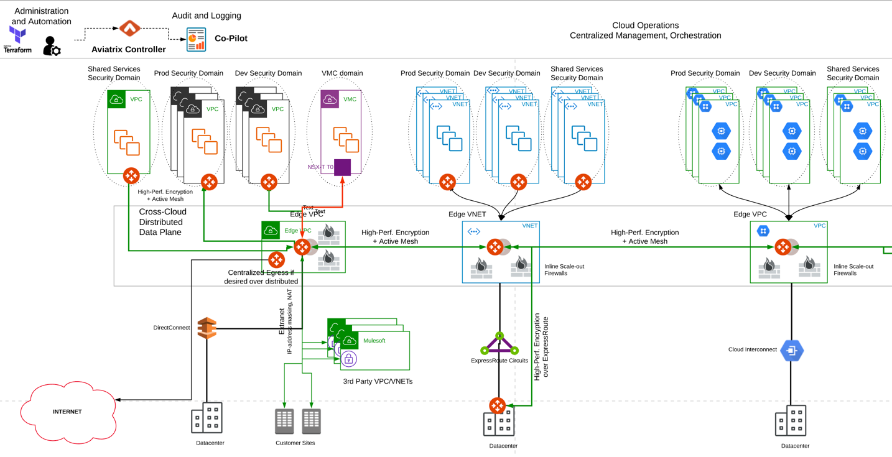

Result: Aviatrix Solution that Meets Design Requirements
CLOUD ACCESS LAYER NETWORKING
6

Slide 8
Result: Aviatrix Solution that Meets Design Requirements
Cloud Operations Layer
Automation Packet Capture
Troubleshooting Health Analysis
Capacity Planning Multi-Account support
Orchestration Visibility and Control
Logging Alerting
Flow Analysis Monitoring
Cloud Security Layer
Network Segmentation (aka Macro-Segmentation)
Distributed Cloud Firewall
End-to-End Encryption
High-Performance Encryption
Secure Egress FQDN
Secure User Access
Secure Site-to-Cloud
DC-to-Cloud Encryption
Core Transit Backbone Layer
Access Routing
Aggregation Routing
Core Routing
L4 FW
NGFW
LB
Internet
Workloads
Storage
SaaS
Vendor Links
Multi-Region
Multicloud
WAN Optimization
Cloud Access Layer
Data Center
Branch
Partner
Users
SD-WAN
MPLS
AWS Direct Connect
Azure ExpressRoute
GCP Cloud Interconnect
Encrypted Access
Internet Backhaul
WAN Optimization
NGFW
Intelligent Edge
5G
IoT
AI Devices
Autonomous Systems
CLOUD ACCESS LAYER NETWORKING
7

Slide 9
Next: Transit Networking

